Slide 1
Chinese Restaurant in NYC
Project Capstone for IBM Data Science Certificate

Slide 2
Business Problem
United Sates of America is an immigration country, which create ethnic diversity. New York as the economic center of U.S., because of this unsurpassed ethnic diversity, the restaurant goer will feel that he has died and gone to heaven while in New York City. The infinite numbers of Chinese dishes, flavors, and methods of cooking which make eating Chinese food joyful and exciting. Ss when someone want open a Chinese restaurant business in NYC, which location and neighborhood is the best? Using data science to analysis and cluster Chinese food to find the best location is best way for owner, this will save both money and time. We will use data to make the decision on the place that is the most convenient for owner's new business.
With the data, we will see all the Chinese Restaurant in NYC with a Map. Once we have the map, we will make a conclusion for the best new location to open a Chinese Restaurant.
With the business problem, following problem will be discussed:
Number of existing Chinese Restaurant in NYC
Number of existing Chinese Restaurant in neighborhood
Population distribution in NYC neighborhoods
Data sources where we will extract information:
NYC map details and coordinates from use Wikipedia information and NYC data Json file from previous Lab: https://cocl.us/new_york_dataset
Chinese Restaurants data in NYC from NYC Open Data
NYC population from NYC Department of Health

Slide 3
Methodology
The methodology will include:
Data retrieval, exploration and visualization
Performing K-means clustering algorithm to segment neighborhoods
Visualizing Chinese Restaurant and neighborhood segments
Visualizing population using color depth map
Explore the best location for new Chinese restaurant by population distribution and clustering.

Slide 4
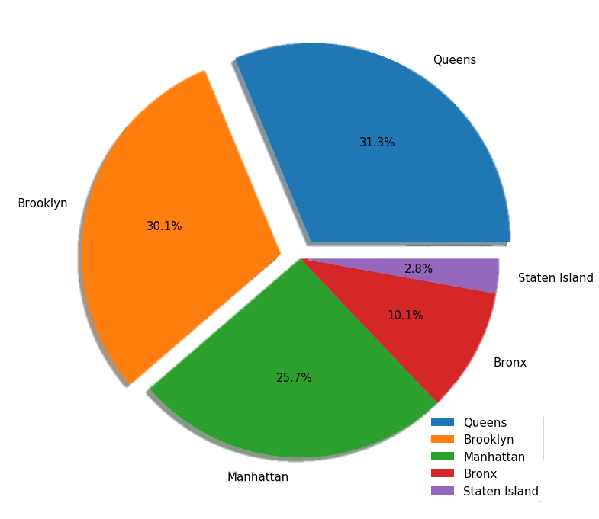
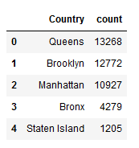
Methodology
Data retrieval, exploration and visualization
The initial data frame contained redundant information such as street, zip codes, phone, etc. So, a new data frame was created with just the columns containing boroughs and Chinese Restaurant Name.
By count the number of Chinese Restaurant in each borough, and visualized with pie chart, it is clearly that Queens and Brooklyn has most Chinese Restaurant in NYC. So, it is worth to investigate both borough and their neighborhoods.

Slide 5
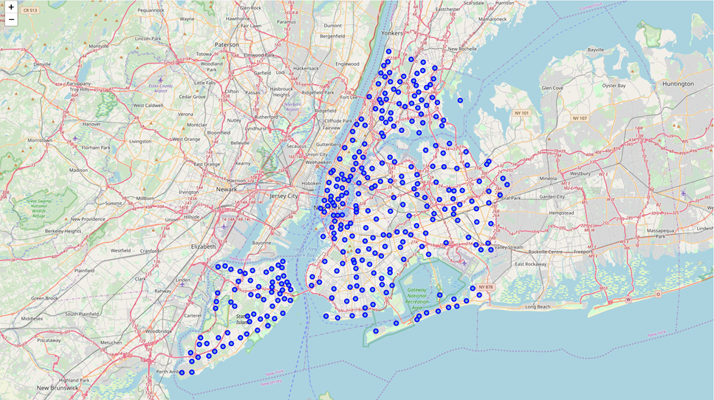
Methodology
Data retrieval, exploration and visualization
In this step, the json data of New York City was import as data frame. The data frame helps explore the features of the neighborhoods.
To start with, all neighborhoods in New York City were visualized on a map using Folium.

Slide 6
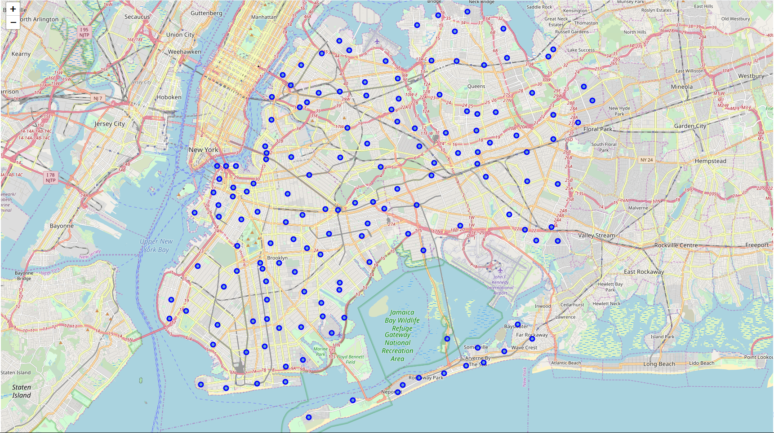
Methodology
Data retrieval, exploration and visualization
In previous step, we know most Chinese restaurant exist in Queens and Brooklyn. So eliminate any other borough and only investigate those two borough and their neighborhoods.
To start with, all neighborhoods in New York City were visualized on a map using Folium.

Slide 7
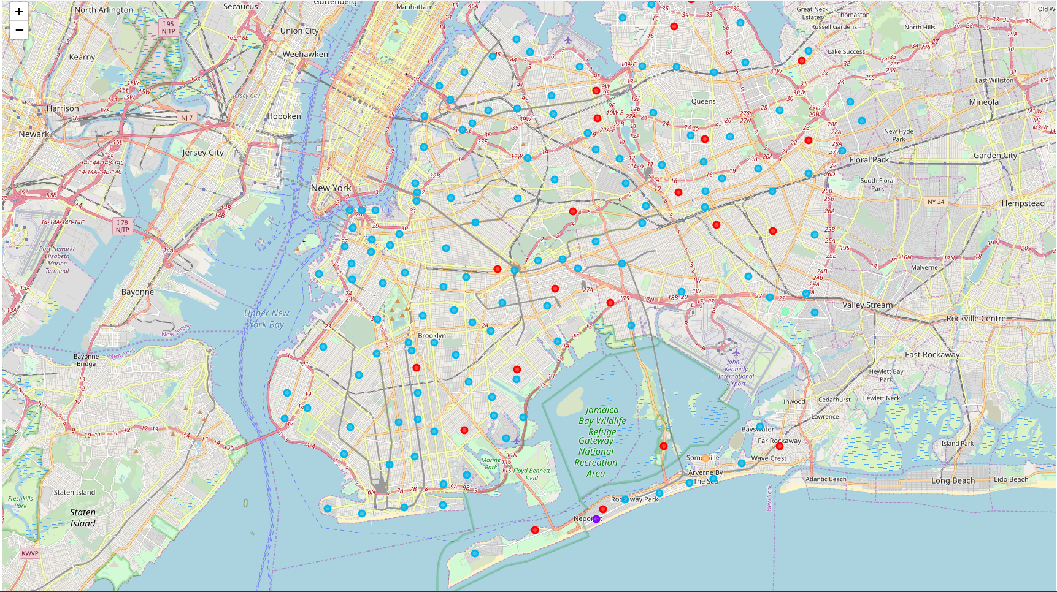
Methodology
Performing K-means Clustering and visualization
Cluster 0 (red) has high frequencies for restaurant category. This appear to be residence dining area
Cluster 1 (purple) has low frequencies for all venue categories. This appears to be small affluent neighborhood. This area geographically close to beach, people likely to come here for outdoor activity. Drinks or fast food would be more popular here.
Cluster 2 (blue) has consistently high frequencies for all venue categories. This is the most diversely developed part of city, most likely to be commercial district.
Cluster 3 (green) has low frequencies. These appear to be bodega and farm area.
Cluster 4 (orange) has low frequencies but with more park and services. This is park and outdoor district.

Slide 8
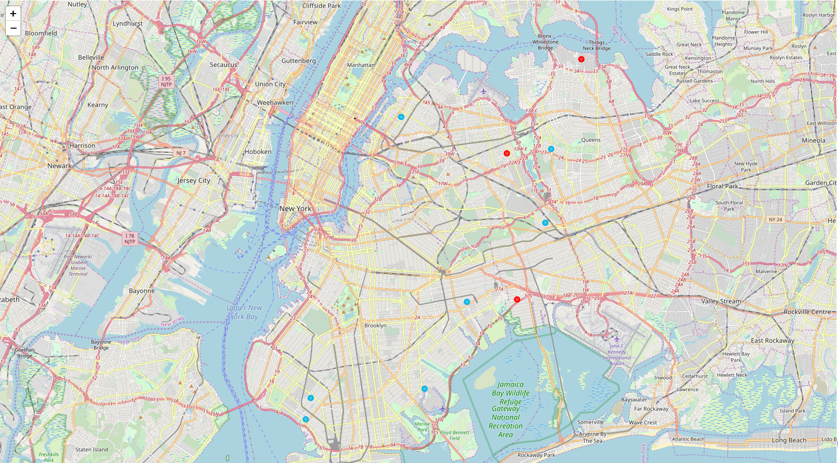
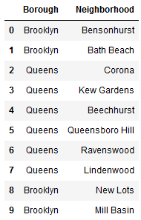
Methodology
Conclusion
Most of the restaurants could be found in cluster 0 and cluster 2.
Cluster 0 has most restaurant in top 10 common venue, this area can be defined as residence dining area.
Cluster 2 has most diversely developed part of the city, most likely to be commercial district, because it also contains many shops.
Both area seems benefit business. And Chinese restaurant in 10 neighborhoods of two clusters are the most common venue, and this tells us that Chinese food is prominent in these area

Slide 9
Future Directions
Built useful models to analysis which location is best for new Chinese Restaurant .
Additional data should be considered to improve accuracy.
Ideas include:
Transportation data (accessibility, parking lot, traffic condition)
Population (Population distribution, food taste )

